Slide 1
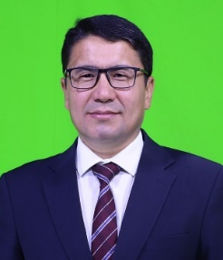
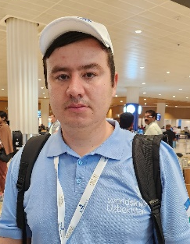
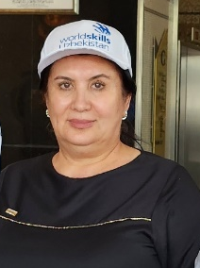
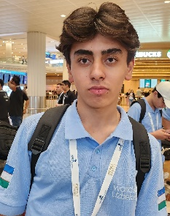
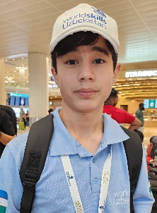
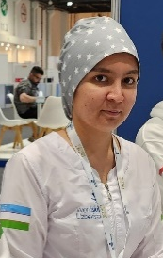
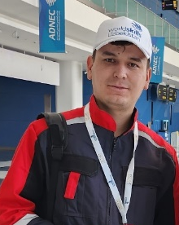
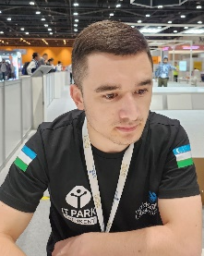
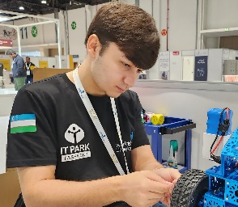
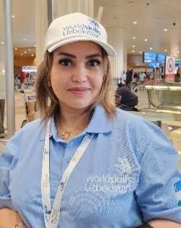
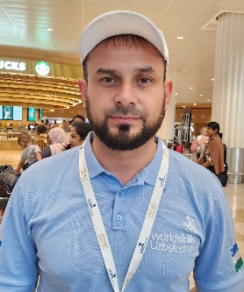
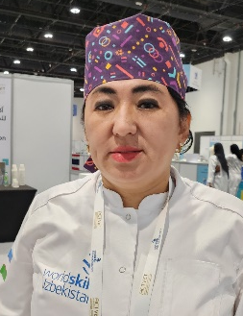

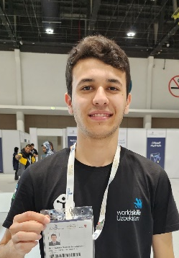
“Worldskills Abu Dhabi Competition 2023”
O’ZBEKISTON MILLIY TERMA JAMOASI
25.11-02.12.2023
Texnik delegat
Xushmurodov Dadaxon Raimovich
Jamoa sardori
Azimov Azizbek Adizovich
Kuzatuvchi -
Sattarova Aygul Yusupbayevna
Sartaroshlik san’ati
Quruq qurilish va suvoq ishlari
Tibbiy va ijtimoiy g’amxo’rlik
Payvandlash texnologiyasi
Mobil robototexnika
Ishtirokchi: Salomov Alirizo Botirovich
Ishtirokchi: Adizov Akobir Azamatovich
Ishtirokchi: Ismoiljonova Charoskhon ILxomjon qizi
Ishtirokchi: Fayzullayev Asliddin Abduraxim o’g’li
Ishtirokchi: Raximjonov Azizbek Sharifjon o’g’li
Ishtirokchi: Matchanov Muxammad O’tkirbek o’g’li
Ekspert: Achilova Nozima Mubinovna
Ekspert: Yashiev Firdavs Farxodovich
Ekspert: Usmanova Elmira Tashmukhametovna
Ekspert: Axmedov Sobirjon Baxodurovich
Ekspert: Khaydarov Sukhrob Suranbayevich

Slide 2
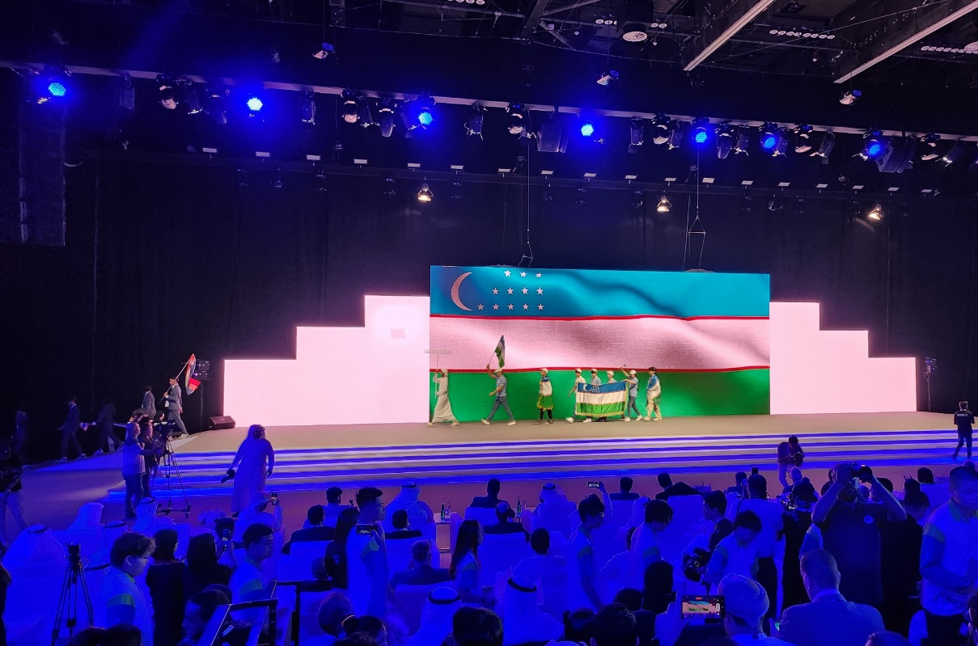
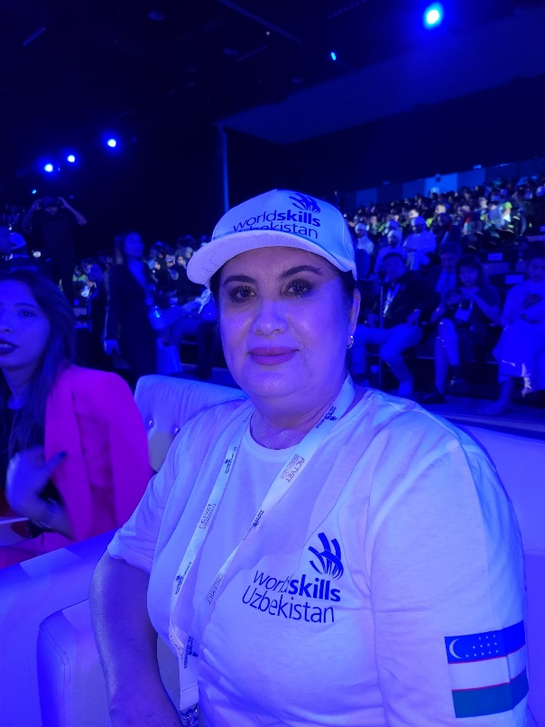
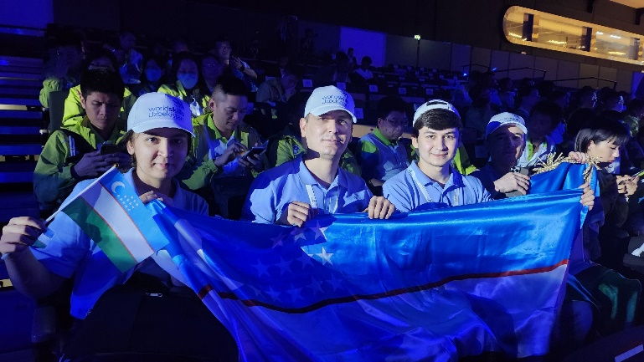
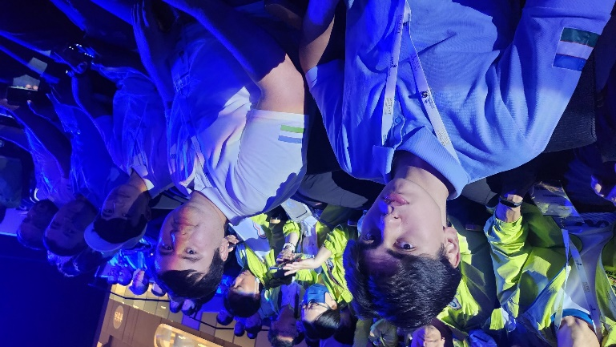
WORLDSKILLS ABU DHABI-2023
OCHILISH MAROSIMI

Slide 3
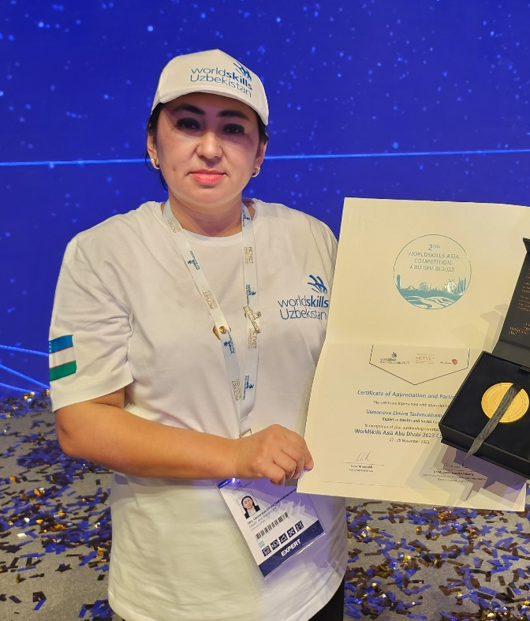
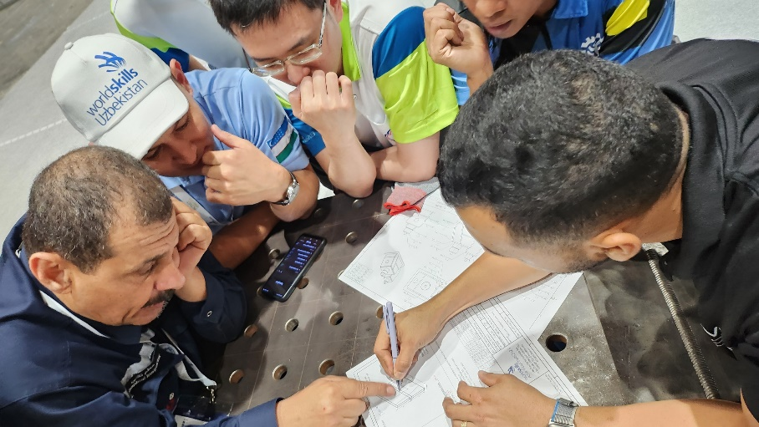
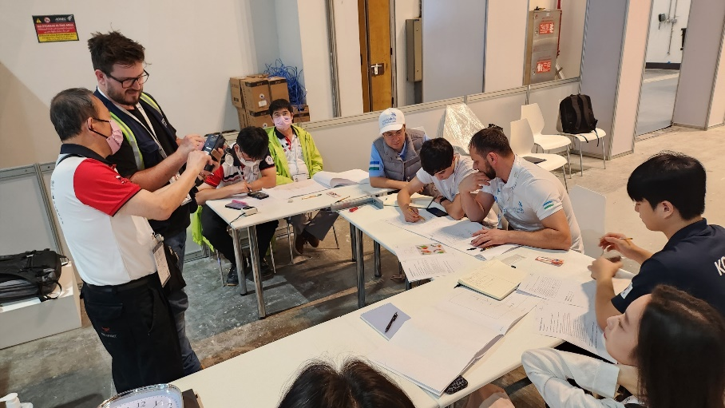
KASBIY MALAKA OSHIRISH KURSI
Ekspertlar uchun malaka oshirish kursi tashkil etiladi

Slide 4
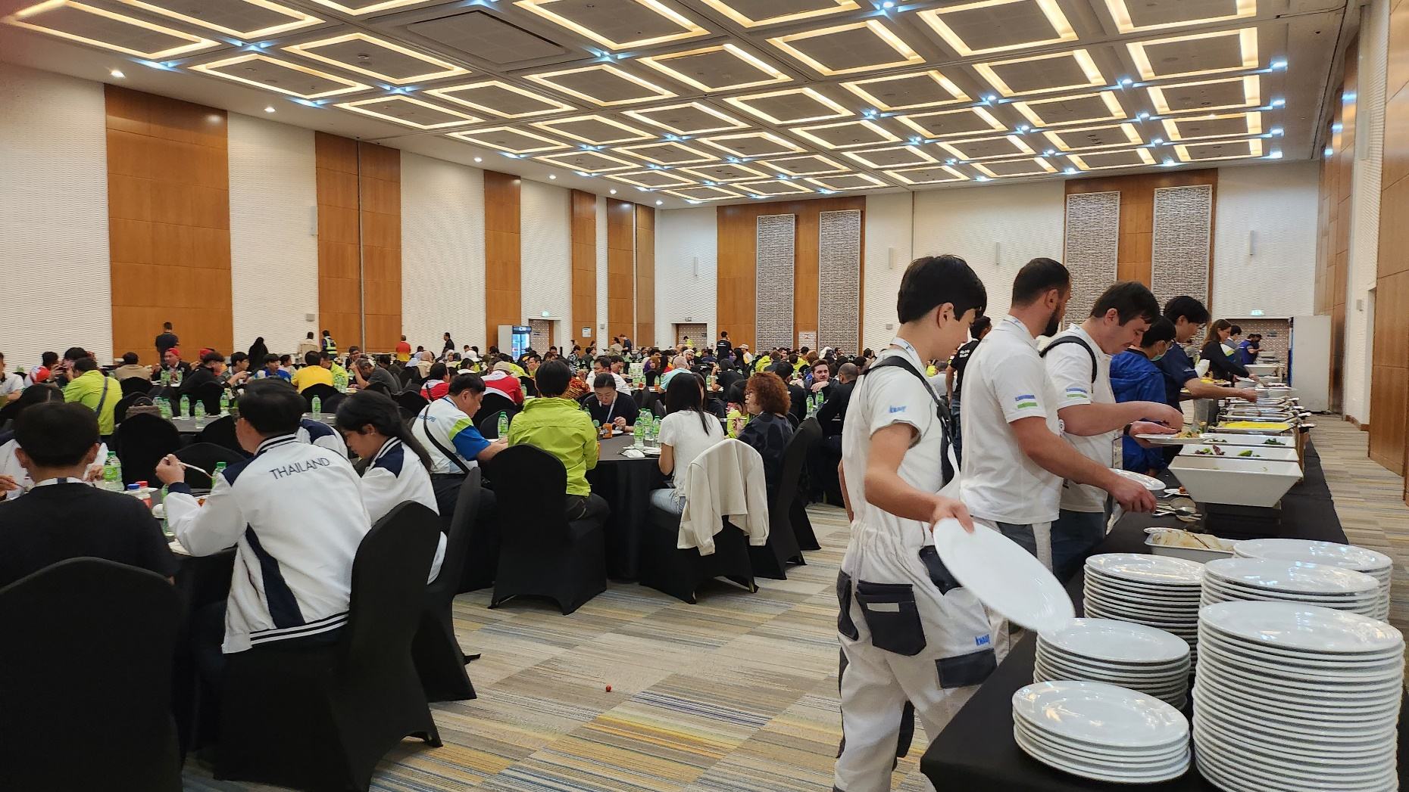
TUSHLIK:

Slide 5
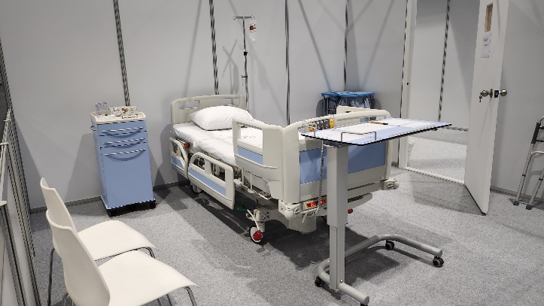
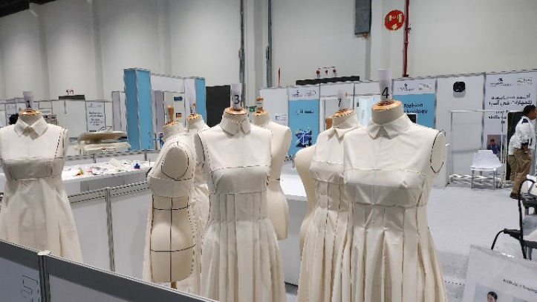
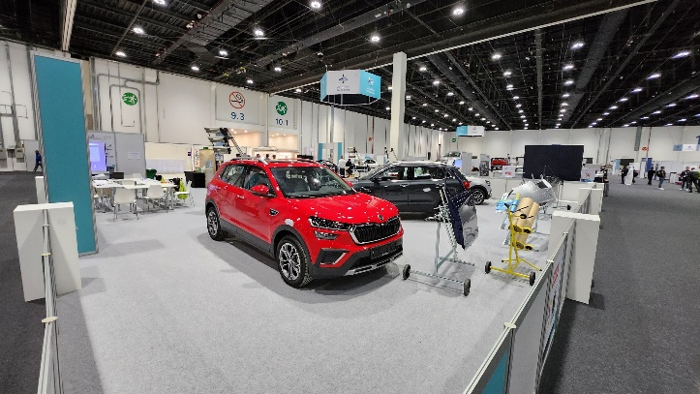
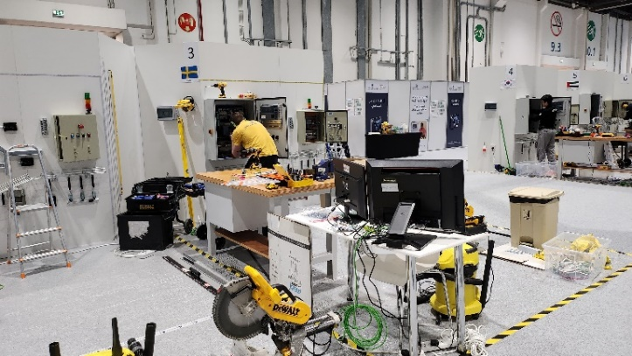
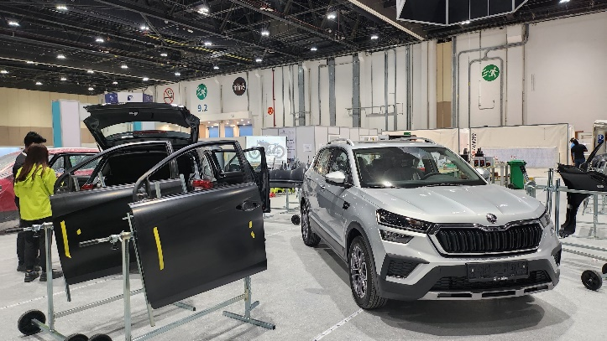
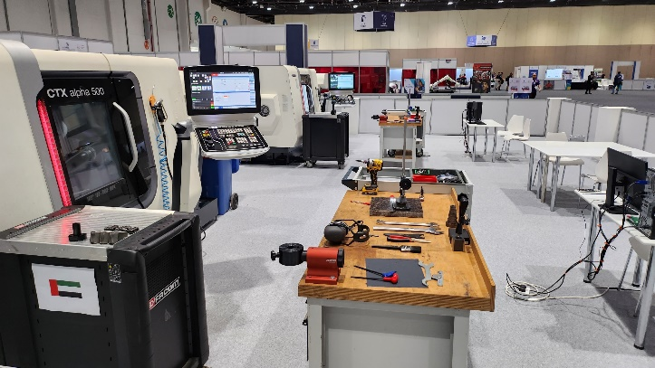
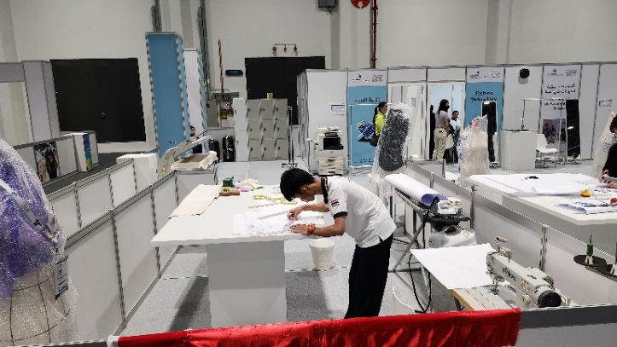
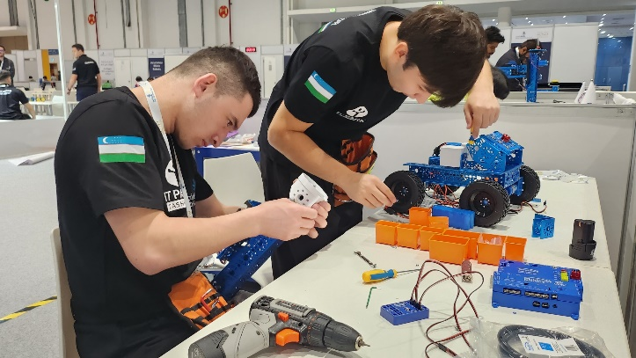
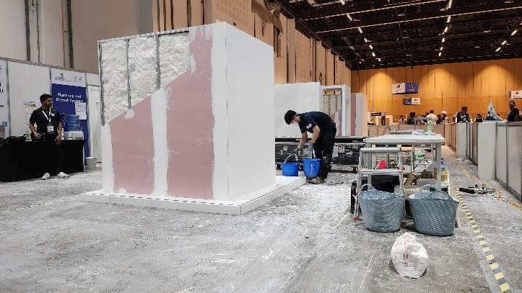
WORLDSKILLS ABU DHABI-2023

Slide 6
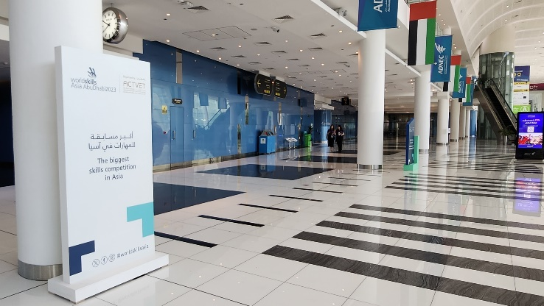
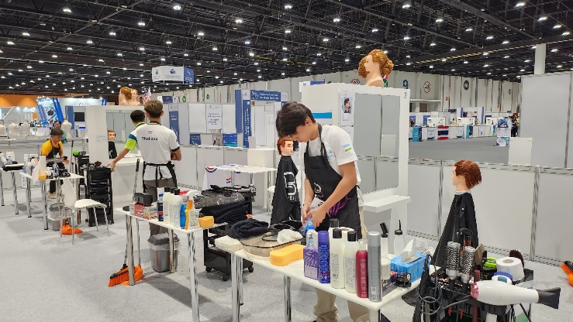
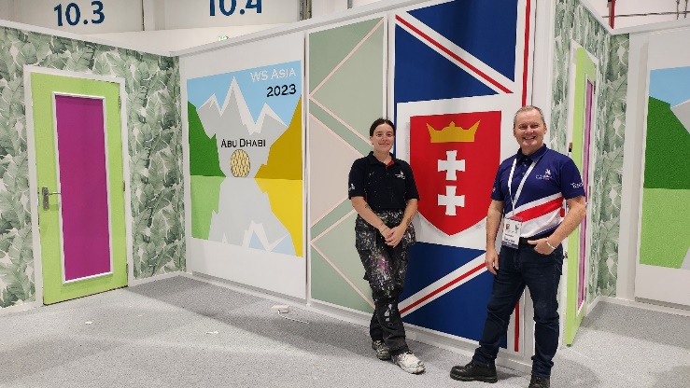
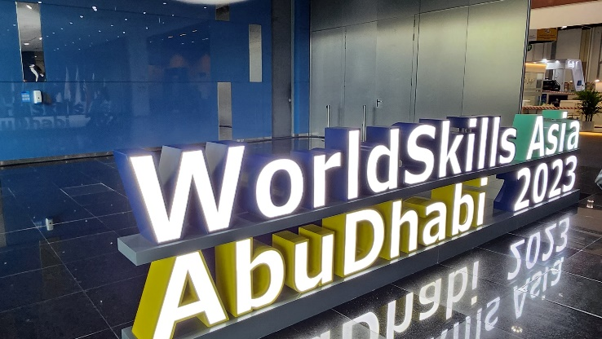
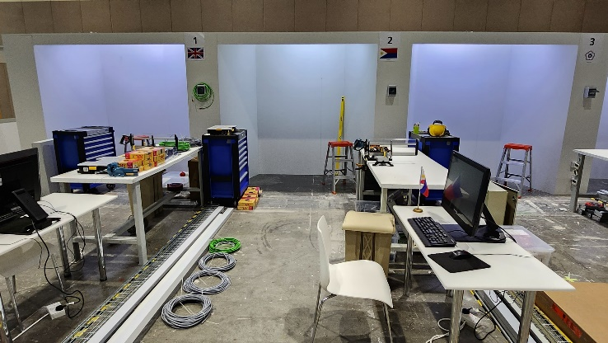
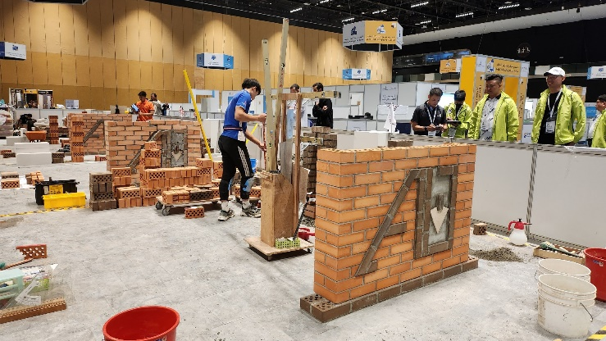
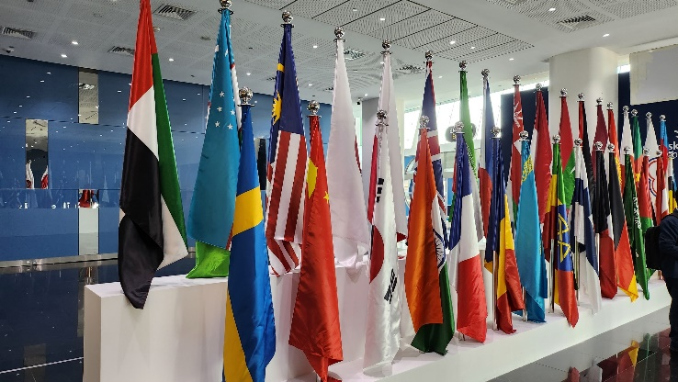
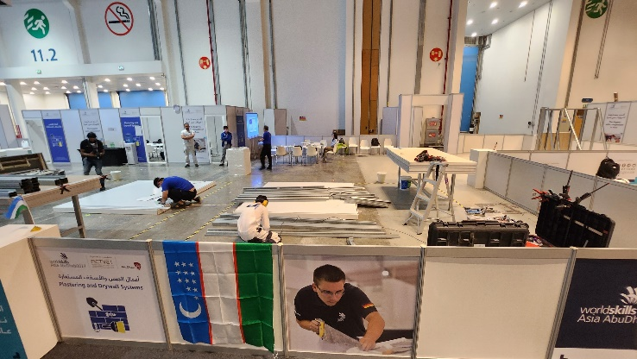
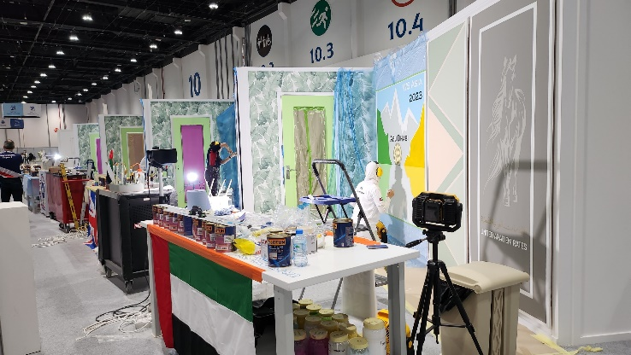
WORLDSKILLS ABU DHABI-2023

Slide 7
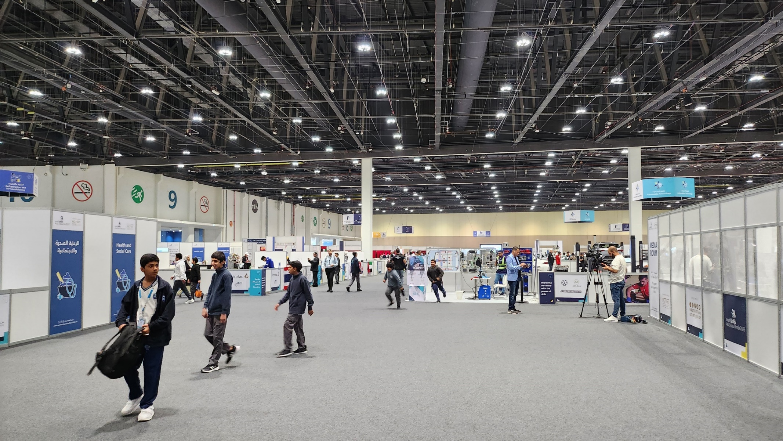
Worldskills Abu Dhabi-2023
Expocenter: Chempionat o’tkaziladigan hudud

Slide 8
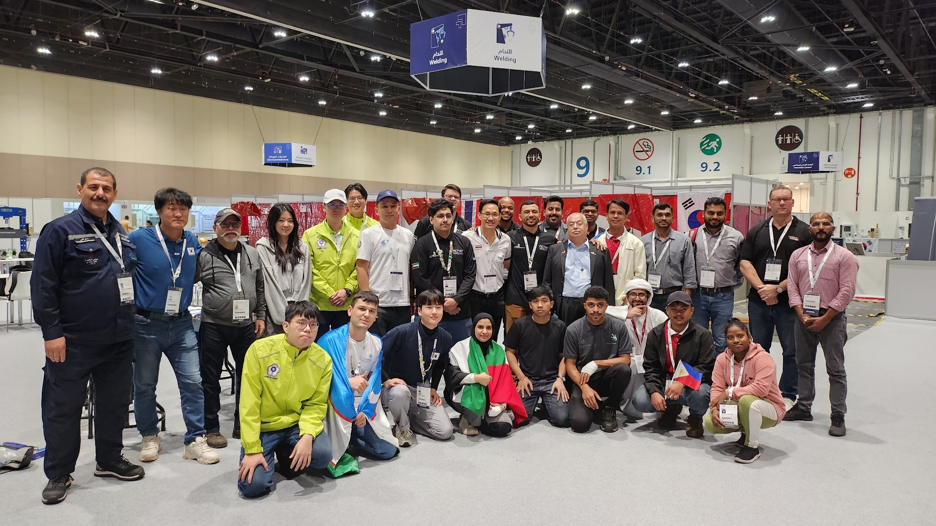
Payvandlash kasbi bo’yicha
Worldskills Abu Dhabi-2023

Slide 9
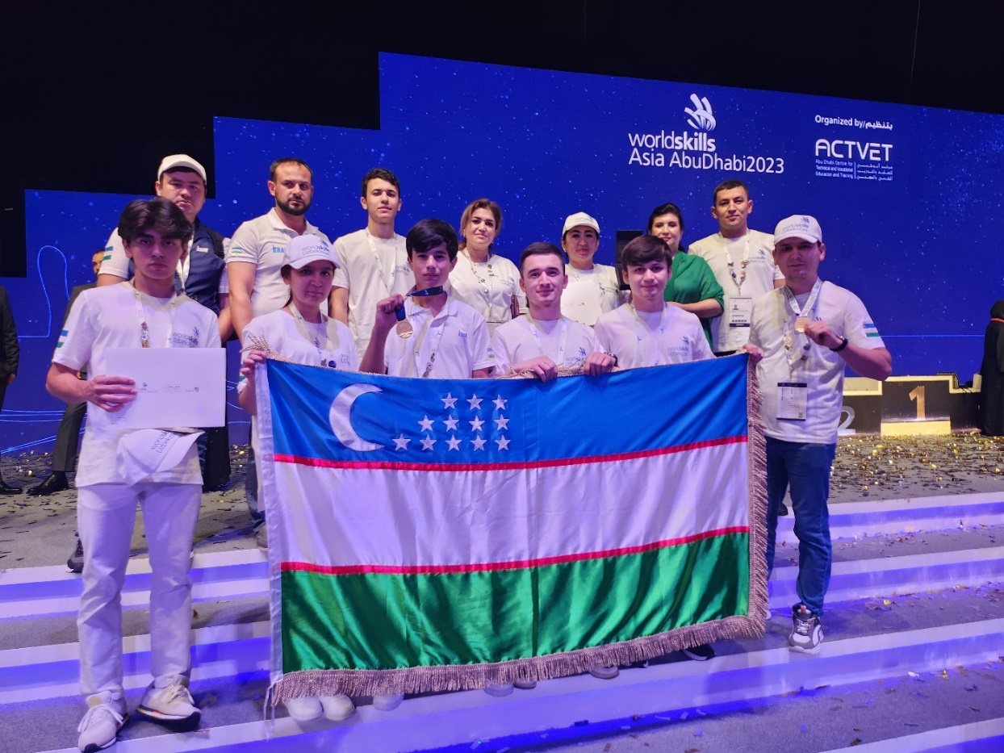
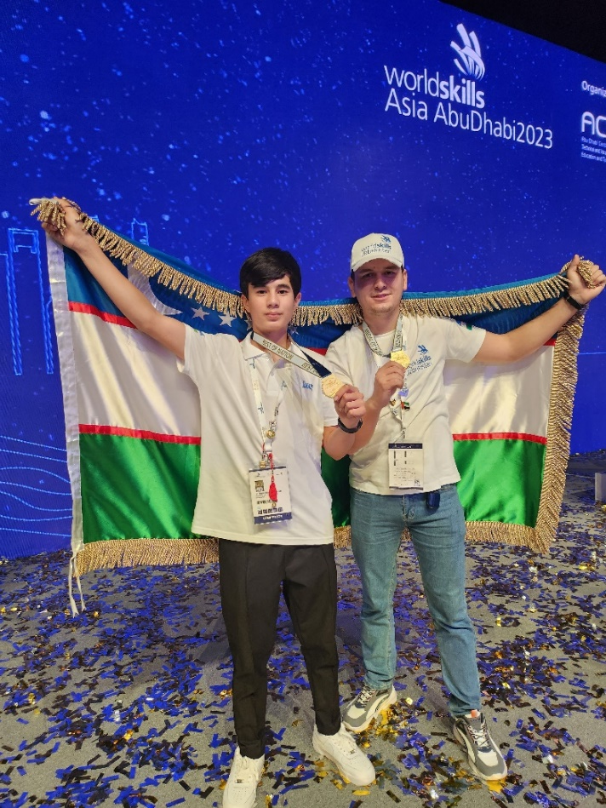
Worldskills Abu Dhabi-2023 CHEMPIONAT NATIJASI
31 ta Davlat
31 ta kasb
600 nafar ishtirokchi
1 ta 3-o’rin. Medal (Millat faxri, Buxoro 11-sinf)
1 ta 4-o’rin. Tashkent KOICA

